Slide 1

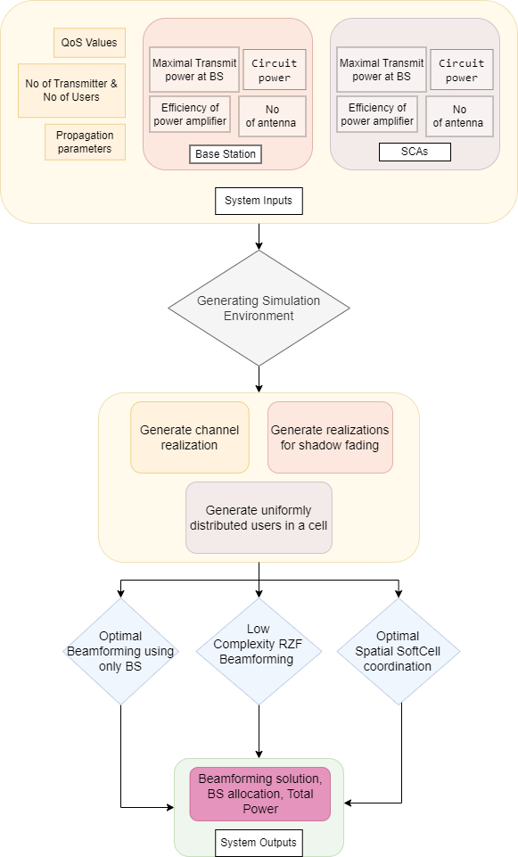
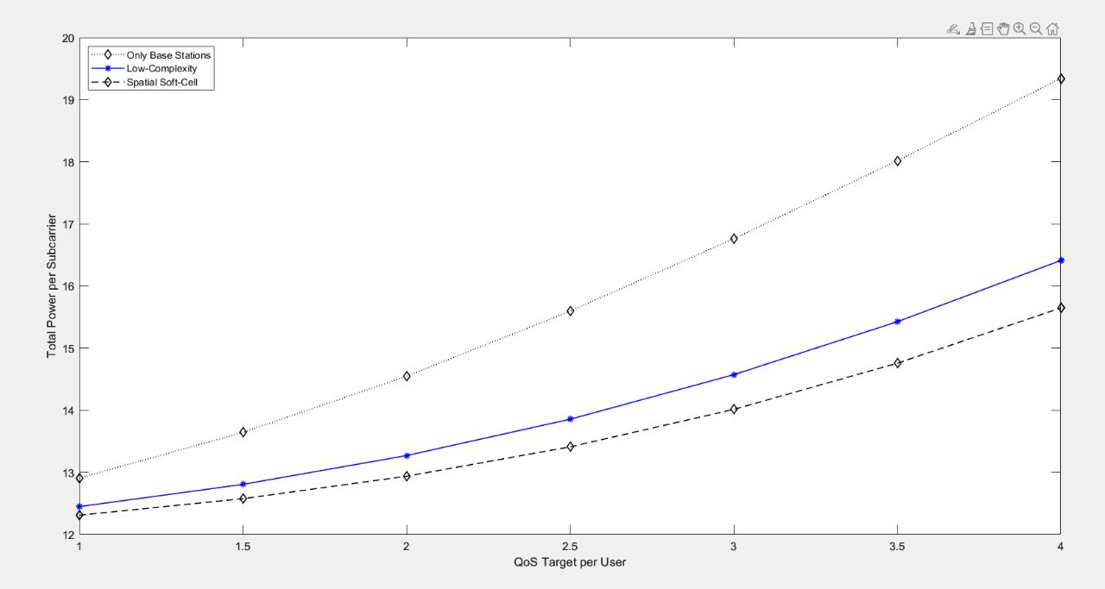
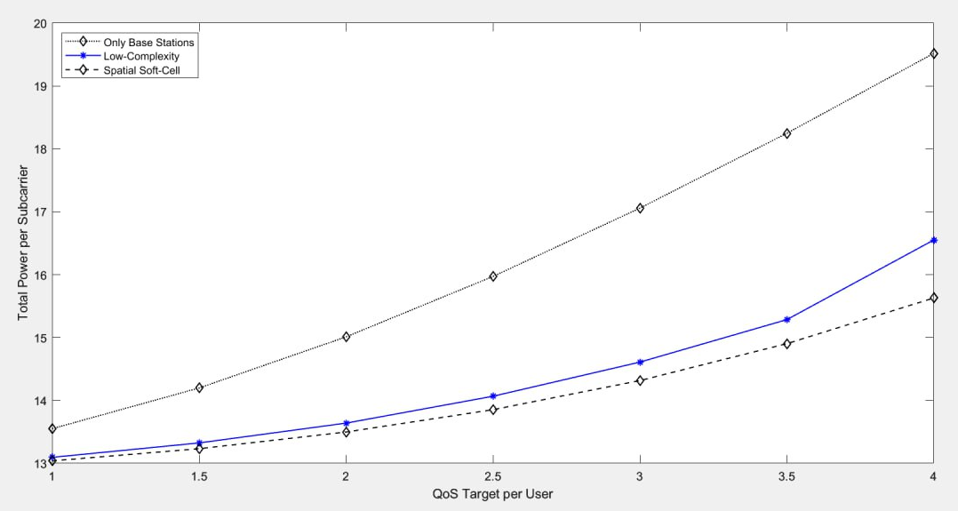
Improving Energy Efficiency through Massive MIMO and Small-Cells
Team Members: Pragathi Pujari, B Ajay Kushal, Lavanya Shahapur, Kushagra Tomar, Ashwini Jannu
Guide: Mr.Parikshit P Hegde Team No: N-4
Problem Domain
Methodology
Results
5G Network
Problem Definition
Improving Cellular Energy Efficiency by Combined Simulation of Massive MIMO and Small-Cells in 5G Networks
Objectives
To minimize the total power consumption while satisfying QoS and power constraints.
To provide promising simulation results showing total power consumption can be improved by combining massive MIMO and small cells.
To compare and analyze the results of the proposed algorithm with other beamforming algorithms.
We can achieve same QoS with reduced total power with both Low Complexity RZF algorithm and Spatial Soft Cell usage in comparison to only BS approach.
Motivation
Conclusions
While providing wide-area coverage, the macro-cell network topology is not capable of meeting increasing user numbers and QoS expectations.
To meet the strict demands of next-generation wireless platforms and 5G networks, it is essential to prioritize maximizing energy efficiency.
The total power of Only BS to achieve QoS is higher than the Low Complexity RZF and Spatial Soft Cell approach.
The total power of Low Complexity RZF is more than the Spatial SoftCell because of its high complexity and computational requirements.

